Slide 1


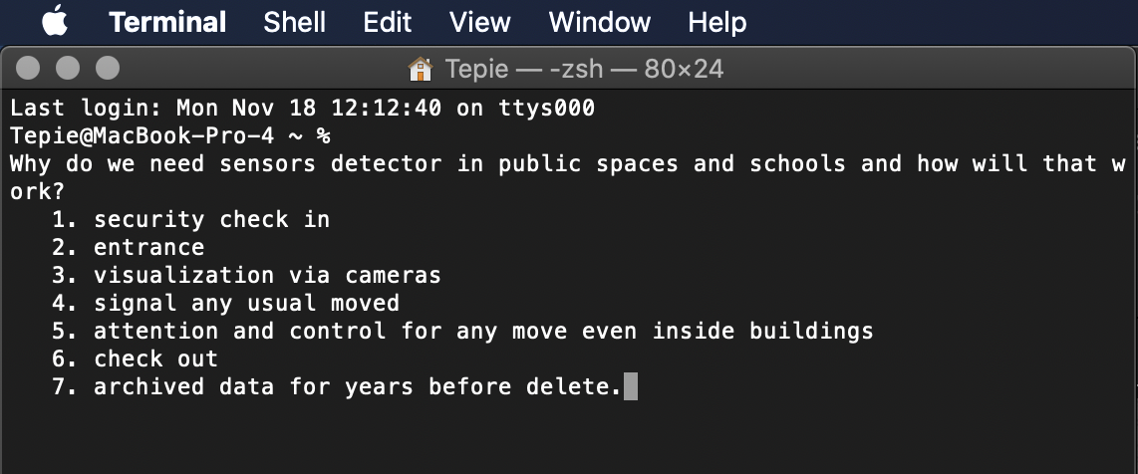

Public school safety
How sensor detectors will control gun entrances in schools
Coding By: Alana Momin and Denise TepiE
Original Coder: https://github.com/RobinDavid/Motion-detection-OpenCV/blob/master/MotionDetector.py

